Slide 1
AINT351: Machine Learning Lecture 5 Bayesian learning example

Slide 2
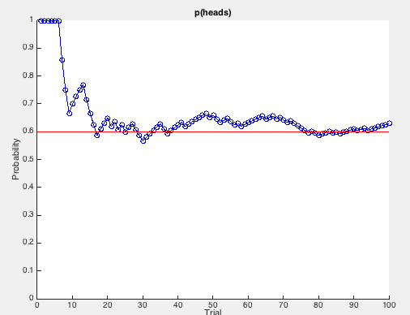
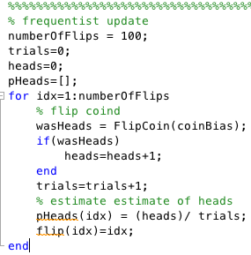
ML estimation of coin flip probability
Might get something like this
after 100 trials:
Use a Matlab simulation with coin bias = 0.6
If get several heads in row then can get inappropriate bias to heads
Can we do better than this?
Here we only have point estimate

Slide 3
Matlab ML estimation Demo

Slide 4
MAP estimation of coin flip probability
Rather than estimating a single θ, we obtain a distribution over possible values of θ
Consider θ = probability of tossing a head as a random variable
We want to take our prior belief of what θ should be into account
Using Bayes theorem we can write the posterior is given by:
Where
is the same as expression from ML estimate with θ fixed to value x
And
Is the probability θ around x without seeing the data – the prior

Slide 5
How should be choose the prior?
Since prior is a distribution then:

Slide 6
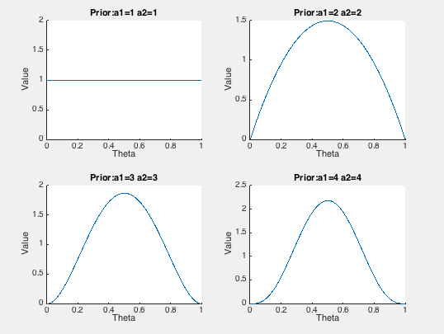
How should be choose the prior?
Want function that can represent the following kind of distributions
A suitable function for the prior is the Beta distribution since
It captures some of these important properties

Slide 7
Beta distribution prior
The Beta distribution is given by
Where the denominator is a scaling factor for the distribution such that

Slide 8
Compute posterior
Put terms into
Likelihood:
Prior:
Thus:

Slide 9
Compute posterior
Since
By marginalization we can calculate the term
But since

Slide 10
Compute posterior
Therefore
We end up with posterior that is also a Beta distribution!
We need to assign α₁ and α₂ to give the required prior
E.g. = 4 gives p(h) = 0.5
Can use MAP estimate as the prior on the next trial

Slide 11
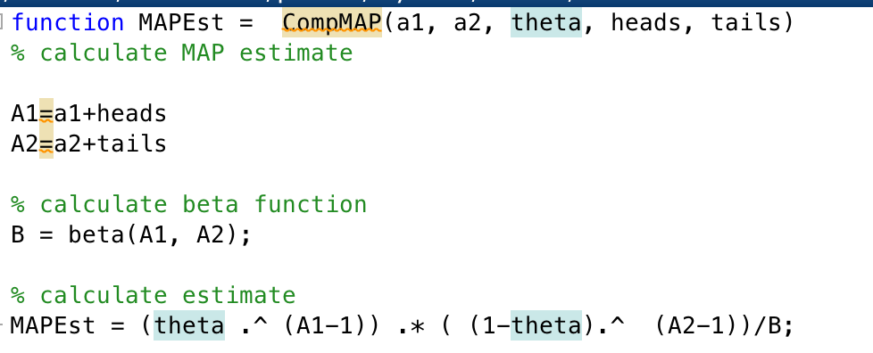
Matlab MAP example

Slide 12
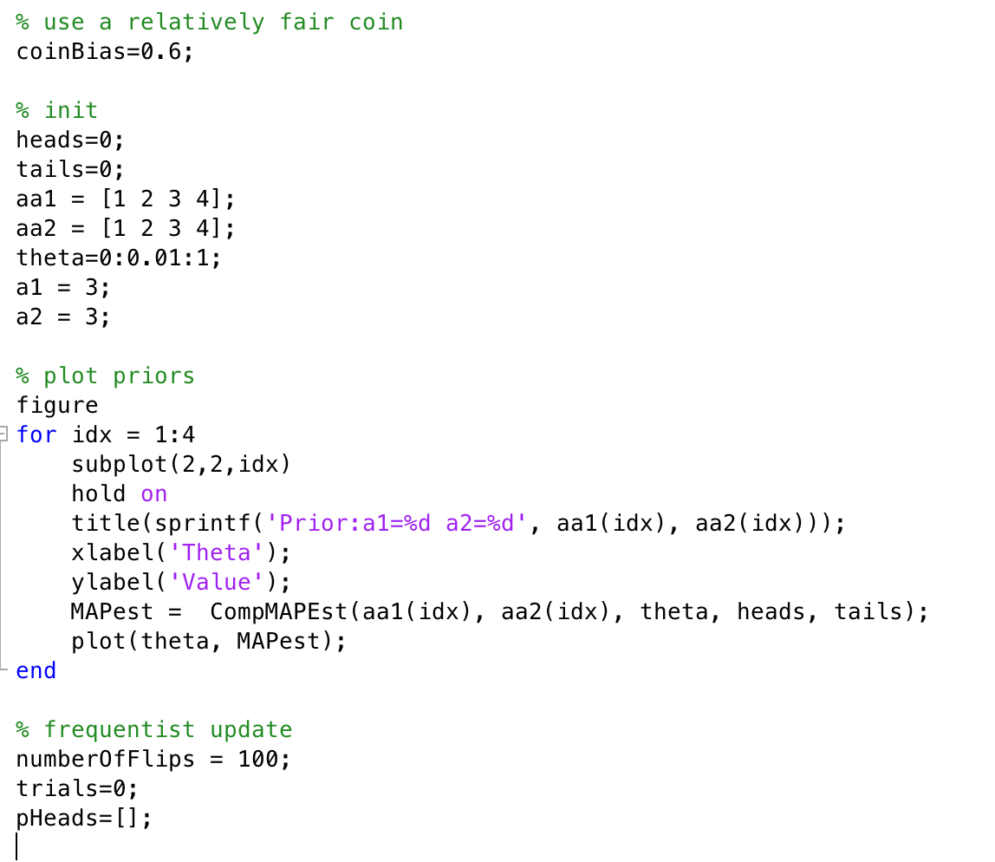
Matlab MAP example
Plot the priors

Slide 13
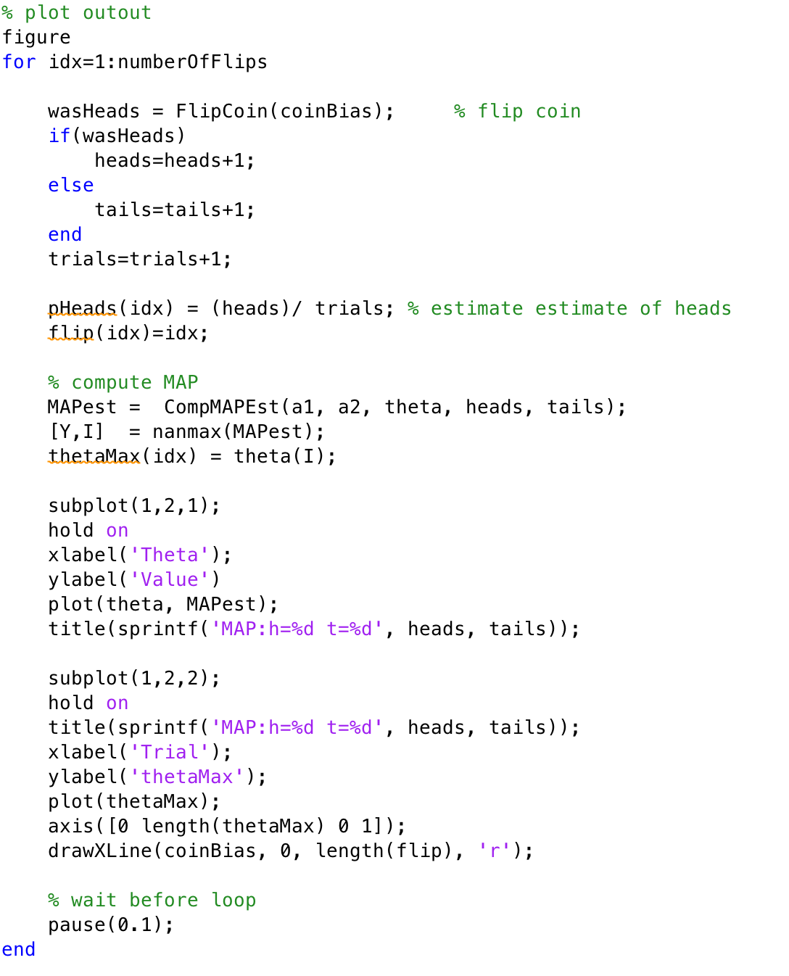
Matlab MAP example
Loop 100 times
Update heads or tails
Compute MAP estimate

Slide 14
Matlab MAP estimation Demo

Slide 15
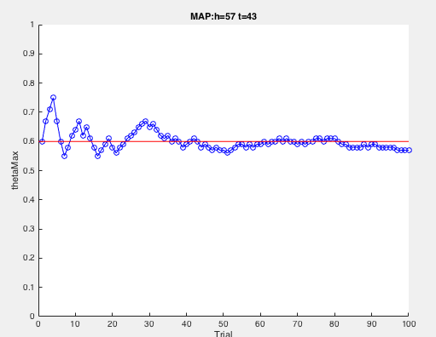
ML versus MAP
ML may run into estimation problems if we are unlucky
ML
Using prior belief means that initial estimate may be more appropriate
MAP

Slide 16
AINT351: Machine Learning Lecture 5 Principle component analysis

Slide 17
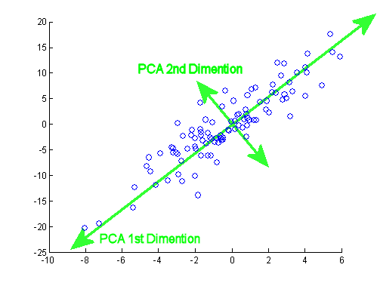
Consider the dataset
In this case most of the variance is along a single diagonal axis

Slide 18
Eigenvectors and PCA
The K principle components are the K eigenvectors with the largest eigenvalues of the data covariance matrix
Equivalent to finding the axis system in which the covariance matrix is diagonal
Eigenvectors can only be found for square matrices
Not every square matrix has eigenvectors
An n x n matrix can have n eigenvectors
All the eigenvectors of a matrix are orthogonal
The length of an eigenvector is exactly on

Slide 19
Principle component analysis
The eigenvalues λ of covariance matrix A are defined as the roots of the equation
The vector x is called an eigenvector of A associated with the eigenvalue.
The K principle components are the K eigenvectors with the largest eigenvalues of the data covariance matrix
This equation is called the characteristic equation
Let be an eigenvalue of A
Then

Slide 20
Eigenvalue problems
Consider simultaneous equations of the form:
where A is an n x n matrix, x is an n x 1 column vector and λ is a scalar (a constant)
The solution to the equation is a vector X
When we transform X by multiplying by A we end up with vector X again but this times scaled by λ
Therefore the direction of vector X is unaffected by the transformation

Slide 21
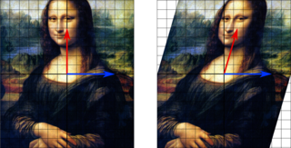

Example eigenvector from Wikipedia
In this shear mapping the red arrow changes direction but the blue arrow does not.
The blue arrow is an eigenvector of this shear mapping because it doesn't change direction.
a horizontal shear

Slide 22

Example eigenvector from Wikipedia
Transformation matrix only preserves the direction of the blue and purple vectors that are parallel to the diagonals
These are the eigenvectors
It does not preserve the direction of the red vectors

Slide 23
Finding eigenvalues and eigenvectors
Given the matrix A
We will now find its eigenvalues and eigenvectors
We must solve the equation
Trivial solution if (A-λ) has an inverse
Otherwise if no inverse det(A-λ)=0 and we want non-trivial solution

Slide 24
Finding eigenvalues and eigenvectors
Remember
Solutions

Slide 25
Finding eigenvalues and eigenvectors
When
Giving
So eigenvectors are proportional to this X vector: e.g
Can
normalize

Slide 26
Finding eigenvalues and eigenvectors
When
Giving
So eigenvectors are proportional to this X vector: e.g.
Is normalized already

Slide 27
The two solutions
So the the matrix A
Has the two eigenvalues
And the two associated eigenvectors

Slide 28
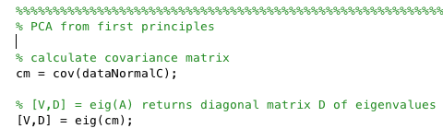
Matlab PCA
In practice you can use functions in Matlab that will do PCA and compute eigenvalues and eigenvectors for you on high dimensionality datasets
Principal components are found by calculating the eigenvectors and eigenvalues of the data covariance matrix
Can also use:
coeff = pca(X) returns the principal component coefficients for the n-by-p data matrix X.

Slide 29
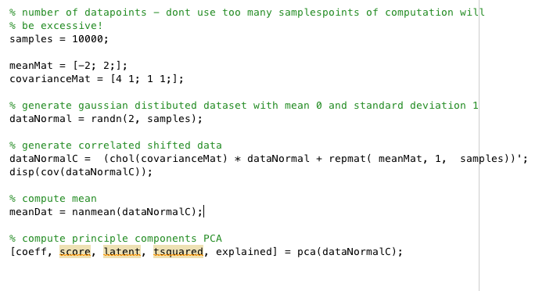
Generate correlated data and run PCA

Slide 30
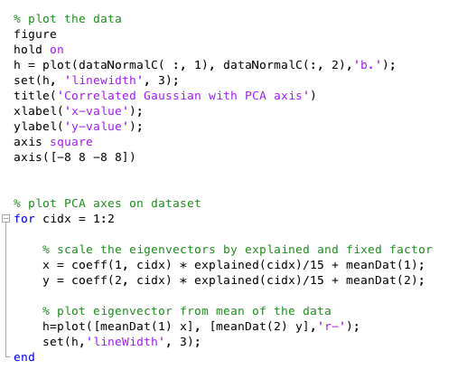
Plot data and eigenvectors

Slide 31
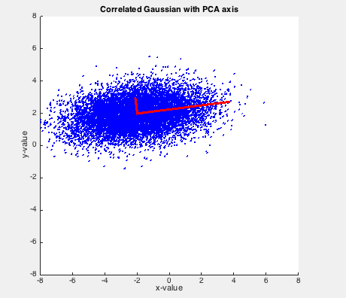
Output from Matlab

Slide 32
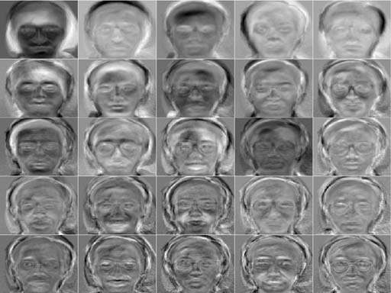
Eigenfaces
Several researchers have applied PCA to face recognition and compression
They can represent features of faces

Slide 33
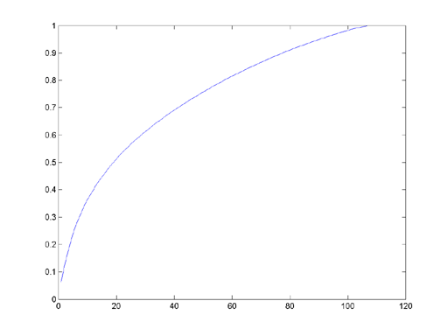
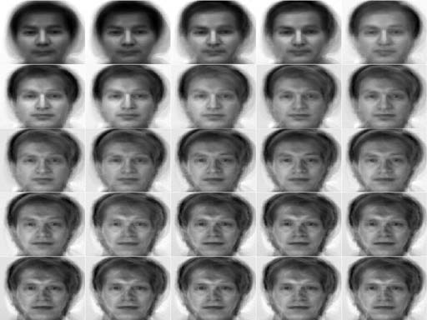
Reconstruction from eigenfaces
Explained variance
Faces become more recognizable as reconstruction and another PC

Slide 34
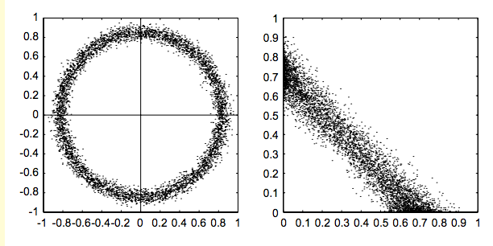
Limitations of PCA
Consider these datasets
Does PCA help here?
(x,y) independent
But strong (x²,y²) dependency!
What about here?
(x,y) negatively correlated

